Slide 1
Mehran S. Fallah May 2020
Programming Languages
Session VI
The Lambda-Calculus

Slide 2
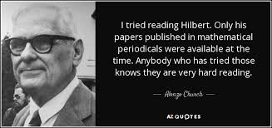
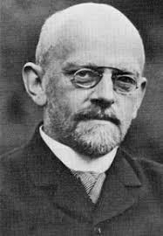
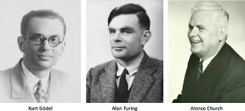
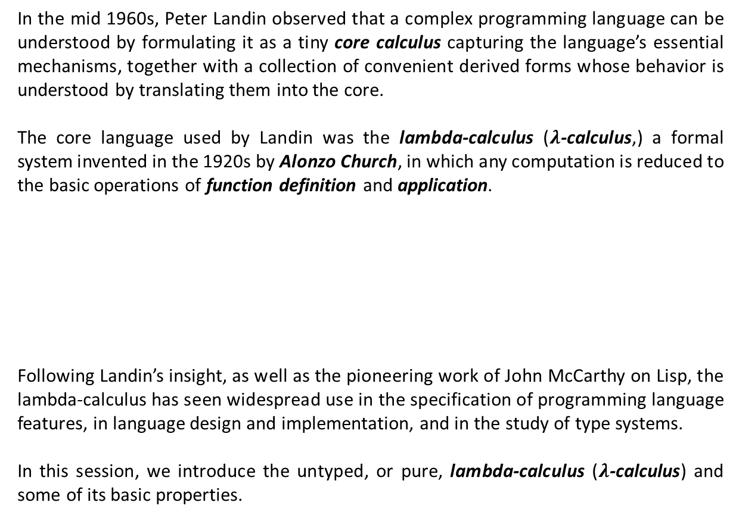
Introduction
In the mid 1960s, Peter Landin observed that a complex programming language can be understood by formulating it as a tiny core calculus capturing the language’s essential mechanisms, together with a collection of convenient derived forms whose behavior is understood by translating them into the core.
The core language used by Landin was the lambda-calculus ($λ$-calculus,) a formal system invented in the 1920s by Alonzo Church, in which any computation is reduced to the basic operations of function definition and application.
Following Landin’s insight, as well as the pioneering work of John McCarthy on Lisp, the lambda-calculus has seen widespread use in the specification of programming language features, in language design and implementation, and in the study of type systems.
In this session, we introduce the untyped, or pure, lambda-calculus ($λ$-calculus) and some of its basic properties.

Slide 3
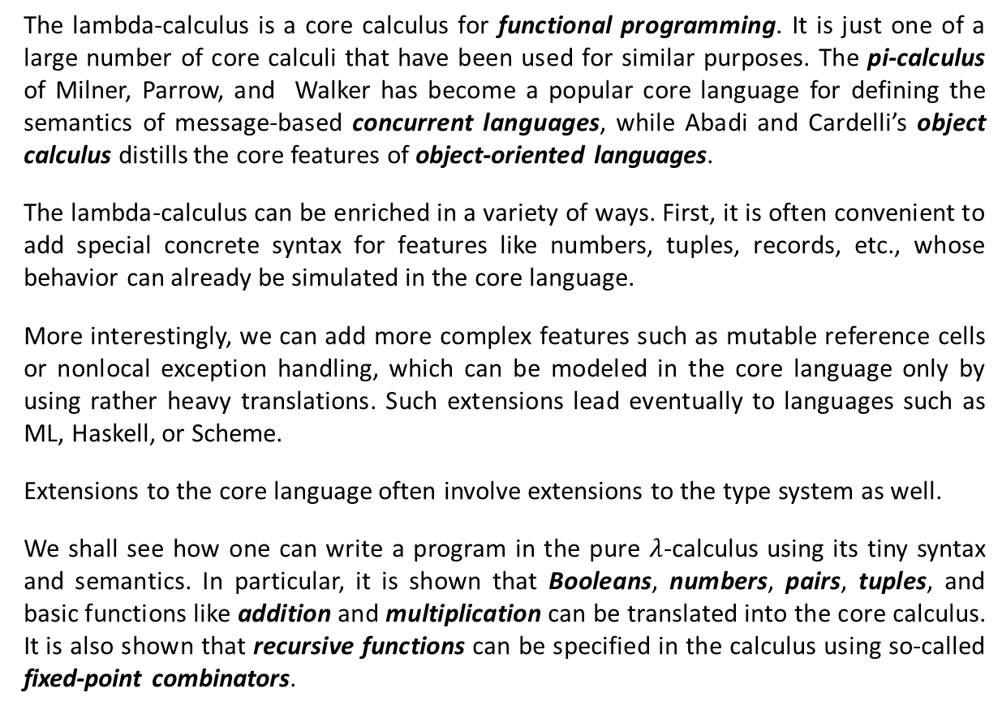
Introduction (Ctd.)
The lambda-calculus is a core calculus for functional programming. It is just one of a large number of core calculi that have been used for similar purposes. The pi-calculus of Milner, Parrow, and Walker has become a popular core language for defining the semantics of message-based concurrent languages, while Abadi and Cardelli’s object calculus distills the core features of object-oriented languages.
The lambda-calculus can be enriched in a variety of ways. First, it is often convenient to add special concrete syntax for features like numbers, tuples, records, etc., whose behavior can already be simulated in the core language.
More interestingly, we can add more complex features such as mutable reference cells or nonlocal exception handling, which can be modeled in the core language only by using rather heavy translations. Such extensions lead eventually to languages such as ML, Haskell, or Scheme.
Extensions to the core language often involve extensions to the type system as well.
We shall see how one can write a program in the pure $λ$-calculus using its tiny syntax and semantics. In particular, it is shown that Booleans, numbers, pairs, tuples, and basic functions like addition and multiplication can be translated into the core calculus. It is also shown that recursive functions can be specified in the calculus using so-called fixed-point combinators.

Slide 4
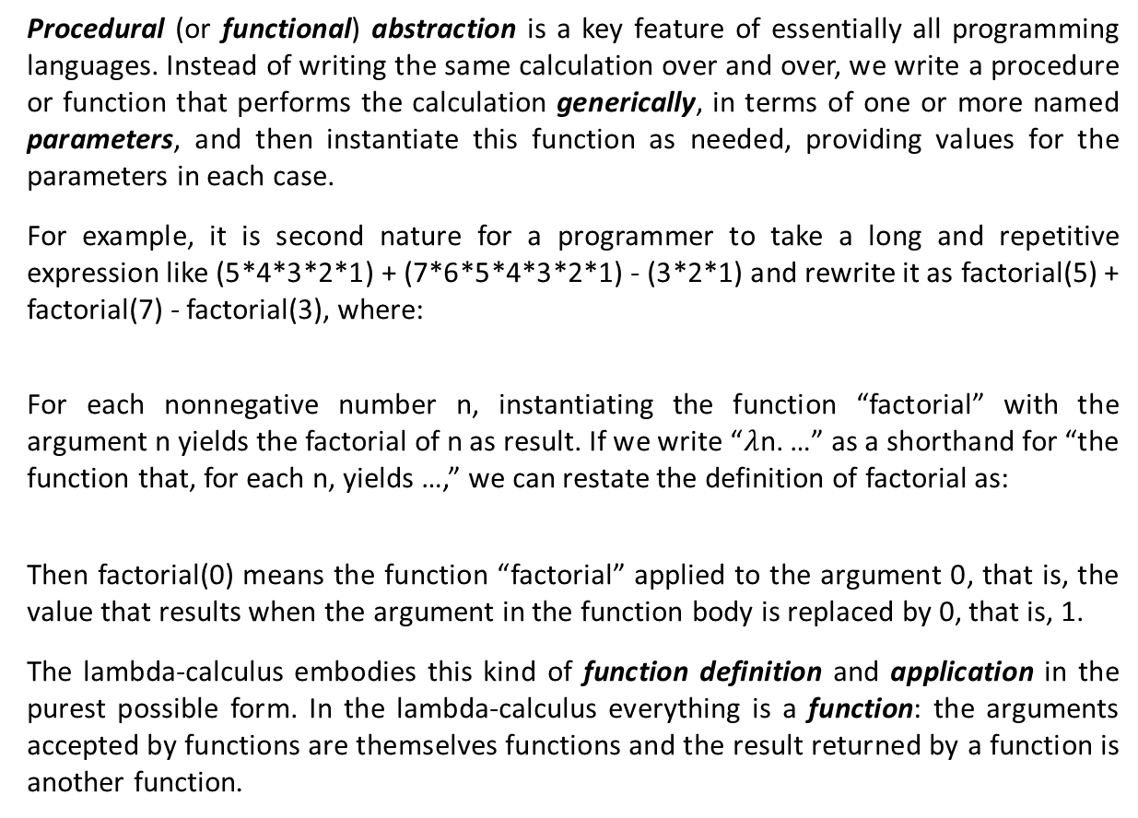
Basics
Procedural (or functional) abstraction is a key feature of essentially all programming languages. Instead of writing the same calculation over and over, we write a procedure or function that performs the calculation generically, in terms of one or more named parameters, and then instantiate this function as needed, providing values for the parameters in each case.
For example, it is second nature for a programmer to take a long and repetitive expression like (5*4*3*2*1) + (7*6*5*4*3*2*1) - (3*2*1) and rewrite it as factorial(5) + factorial(7) - factorial(3), where:
For each nonnegative number n, instantiating the function “factorial” with the argument n yields the factorial of n as result. If we write “$λ$n. …” as a shorthand for “the function that, for each n, yields …,” we can restate the definition of factorial as:
Then factorial(0) means the function “factorial” applied to the argument 0, that is, the value that results when the argument in the function body is replaced by 0, that is, 1.
The lambda-calculus embodies this kind of function definition and application in the purest possible form. In the lambda-calculus everything is a function: the arguments accepted by functions are themselves functions and the result returned by a function is another function.
factorial(n) = if n=0 then 1 else n * factorial(n-1).
factorial = $λ$n. if n=0 then 1 else n * factorial(n-1).

Slide 5
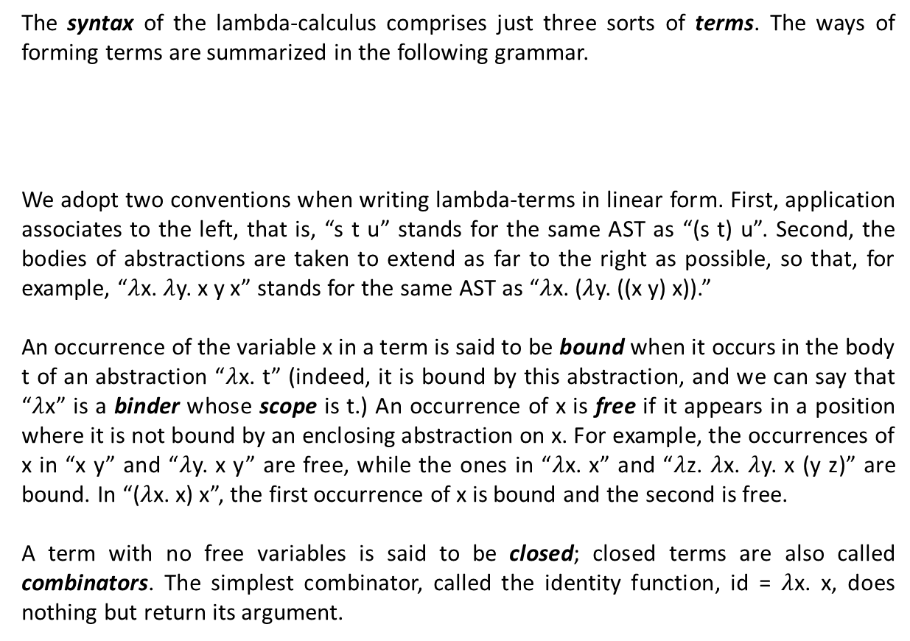

Syntax
The syntax of the lambda-calculus comprises just three sorts of terms. The ways of forming terms are summarized in the following grammar.
We adopt two conventions when writing lambda-terms in linear form. First, application associates to the left, that is, “s t u” stands for the same AST as “(s t) u”. Second, the bodies of abstractions are taken to extend as far to the right as possible, so that, for example, “$λ$x. $λ$y. x y x” stands for the same AST as “$λ$x. ($λ$y. ((x y) x)).”
An occurrence of the variable x in a term is said to be bound when it occurs in the body t of an abstraction “$λ$x. t” (indeed, it is bound by this abstraction, and we can say that “$λ$x” is a binder whose scope is t.) An occurrence of x is free if it appears in a position where it is not bound by an enclosing abstraction on x. For example, the occurrences of x in “x y” and “$λ$y. x y” are free, while the ones in “$λ$x. x” and “$λ$z. $λ$x. $λ$y. x (y z)” are bound. In “($λ$x. x) x”, the first occurrence of x is bound and the second is free.
A term with no free variables is said to be closed; closed terms are also called combinators. The simplest combinator, called the identity function, id = $λ$x. x, does nothing but return its argument.
t ::= x | $λ$x. t | t t
term
variable
abstraction
application

Slide 6


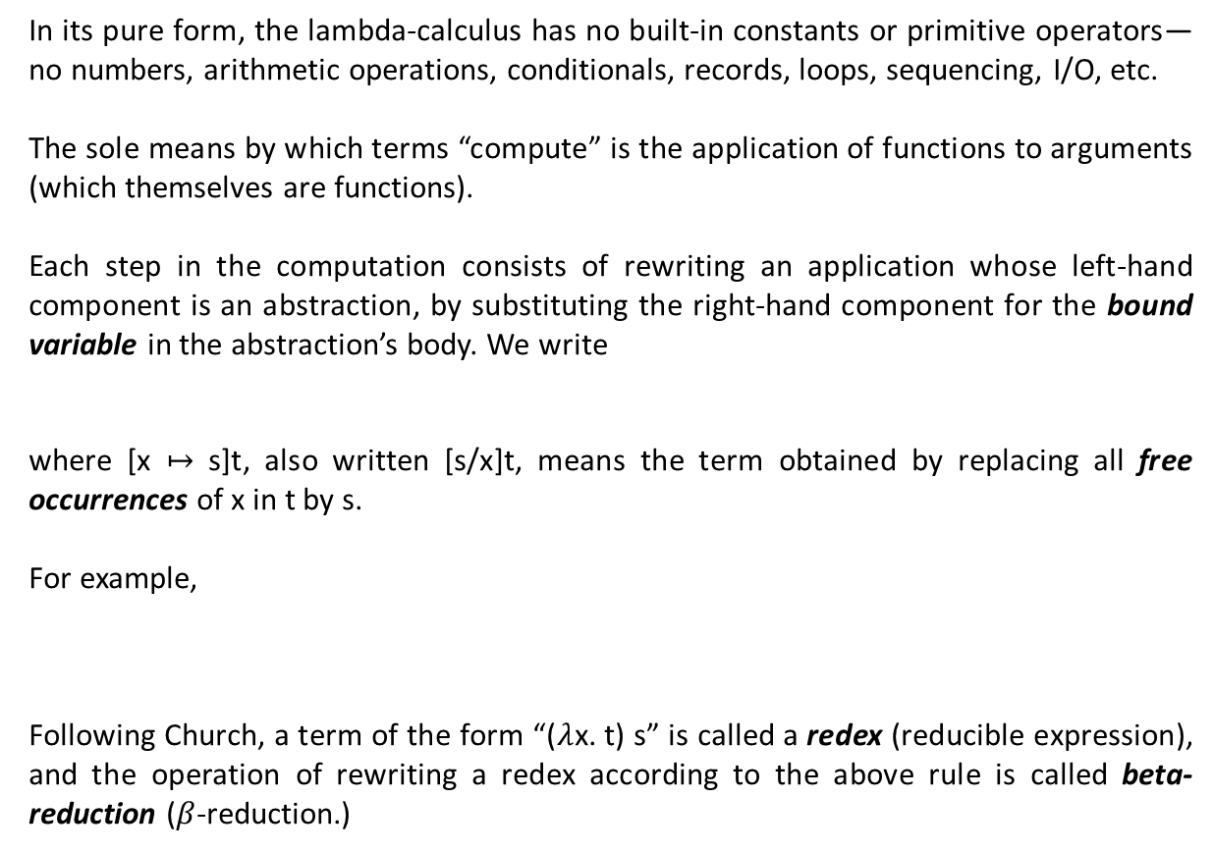




Semantics
In its pure form, the lambda-calculus has no built-in constants or primitive operators—no numbers, arithmetic operations, conditionals, records, loops, sequencing, I/O, etc.
The sole means by which terms “compute” is the application of functions to arguments (which themselves are functions).
Each step in the computation consists of rewriting an application whose left-hand component is an abstraction, by substituting the right-hand component for the bound variable in the abstraction’s body. We write
where [x $↦$ s]t, also written [s/x]t, means the term obtained by replacing all free occurrences of x in t by s.
For example,
Following Church, a term of the form “($λ$x. t) s” is called a redex (reducible expression), and the operation of rewriting a redex according to the above rule is called beta-reduction ($β$-reduction.)
($λ$x. t) s $⟶$ [x $↦$ s]t,
($λ$x. x) y
$⟶$ [x $↦$y]x
= y
($λ$x. x ($λ$x.x)) (u r)
$$⟶\text{[}\text{x} ↦ \text{(}\text{u} \text{r}\text{)] (}\text{x}\text{ (}λ\text{x}\text{.}\text{x}\text{))}$$
= (u r) ($λ$x.x)

Slide 7







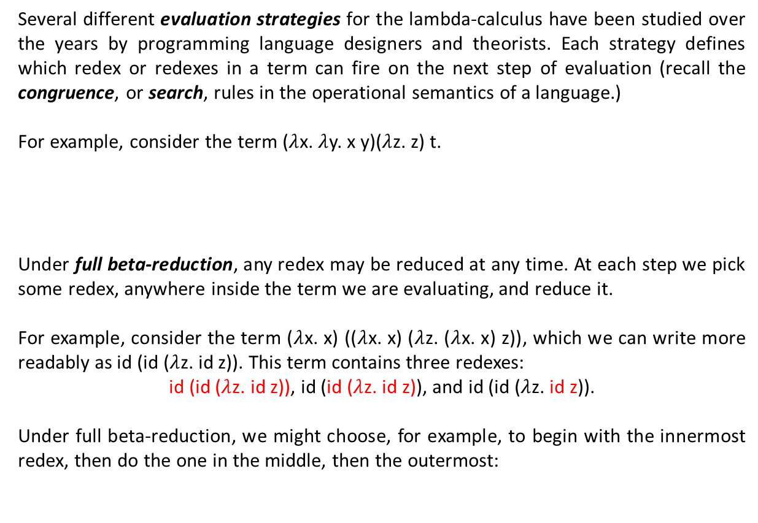










Semantics (Ctd.)
Several different evaluation strategies for the lambda-calculus have been studied over the years by programming language designers and theorists. Each strategy defines which redex or redexes in a term can fire on the next step of evaluation (recall the congruence, or search, rules in the operational semantics of a language.)
For example, consider the term ($λ$x. $λ$y. x y)($λ$z. z) t.
Under full beta-reduction, any redex may be reduced at any time. At each step we pick some redex, anywhere inside the term we are evaluating, and reduce it.
For example, consider the term ($λ$x. x) (($λ$x. x) ($λ$z. ($λ$x. x) z)), which we can write more readably as id (id ($λ$z. id z)). This term contains three redexes:
id (id ($λ$z. id z)), id (id ($λ$z. id z)), and id (id ($λ$z. id z)).
Under full beta-reduction, we might choose, for example, to begin with the innermost redex, then do the one in the middle, then the outermost:
($λ$y. y) t
$$⟶$$
t
($λ$x. $λ$y. x y)($λ$z. z) t
$$⟶$$
($λ$y. $(λ$z. z) y) t
$$⟶$$
$$⟶$$
($λ$z. z) t
$$⟶$$
t
id (id ($λ$z. id z))
$$⟶$$
id (id ($λ$z. z))
$$⟶$$
id ($λ$z. z)
$$⟶$$
$λ$z. z
$$↛$$

Slide 8





















Semantics (Ctd.)
Under the normal order strategy, the leftmost, outermost redex is always reduced first. Under this strategy, the term above would be reduced as follows:
The call-by-name strategy is yet more restrictive, allowing no reductions inside abstractions. Starting from the same term, we would perform the first two reductions as under normal-order, but then stop before the last and regard “$λ$z. id z” as a normal form:
Variants of call by name have been used in some well-known programming languages, notably Algol-60 and Haskell. Haskell actually uses an optimized version known as call by need that, instead of re-evaluating an argument each time it is used, overwrites all occurrences of the argument with its value the first time it is evaluated, avoiding the need for subsequent re-evaluation.
Most languages use a call-by-value strategy, in which only outermost redexes are reduced and where a redex is reduced only when its right-hand side has already been reduced to a value—a term that is finished computing and cannot be reduced any further.
id (id ($λ$z. id z))
$$⟶$$
id ($λ$z. id z)
$$⟶$$
$λ$z. id z
$$⟶$$
$λ$z. z
$$↛$$
id (id ($λ$z. id z))
$$⟶$$
id ($λ$z. id z)
$$⟶$$
$λ$z. id z
$$↛$$
The call-by-value strategy is strict, in the sense that the arguments to functions are always evaluated, whether or not they are used by the body of the function. In contrast, non-strict (or lazy) strategies such as call-by-name and call-by-need evaluate only the arguments that are actually used.
id (id ($λ$z. id z))
$$⟶$$
id ($λ$z. id z)
$$⟶$$
$λ$z. id z
$$↛$$

Slide 9
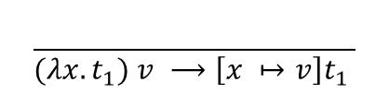
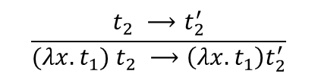
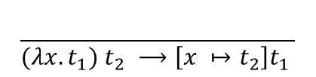
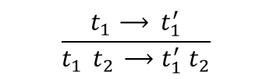


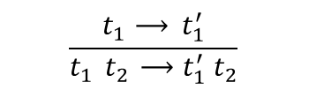
Semantics (Ctd.)
The semantics of the lambda-calculus can be defined inductively as follows:
Call-by-Name | Call-by-Value
$v ∷=$ $λx. t$
$v ∷=$ $λx. t$
$$\frac{t_{1}⟶{ t}_{1}^{′}}{t_{1}{ t}_{2} ⟶t_{1}^{′} t_{2}}$$
$$\frac{t_{1}⟶{ t}_{1}^{′}}{t_{1}{ t}_{2} ⟶t_{1}^{′} t_{2}}$$
$$\frac{}{{(λx.t}_{1}) t_{2} ⟶\left[x ↦t_{2}\right]t_{1} }$$
$$\frac{t_{2} ⟶t_{2}^{′}}{{(λx.t}_{1}) t_{2} ⟶\left(λx. t_{1}\right)t_{2}^{′}}$$
$$\frac{}{{(λx.t}_{1}) v ⟶\left[x ↦v\right]t_{1} }$$

Slide 10
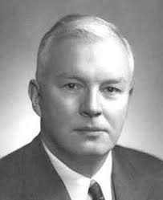

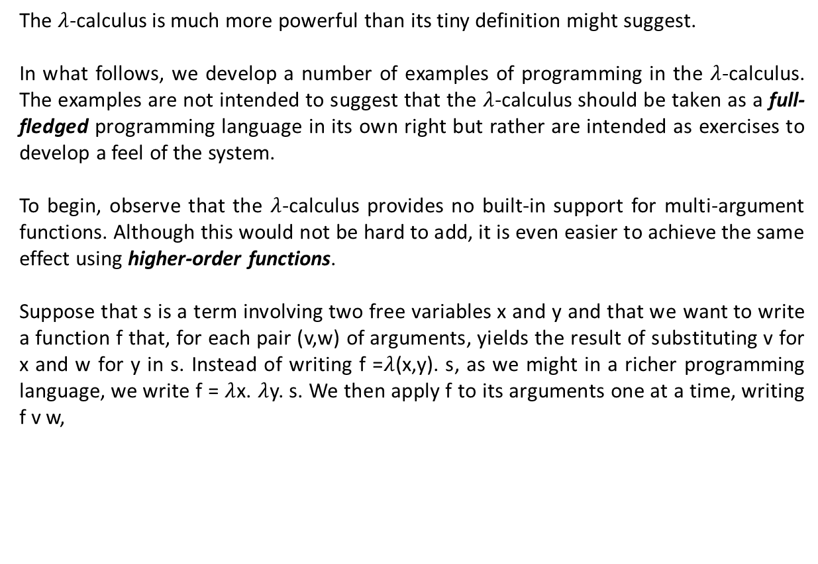




Programming in the $λ$-Calculus
The $λ$-calculus is much more powerful than its tiny definition might suggest.
In what follows, we develop a number of examples of programming in the $λ$-calculus. The examples are not intended to suggest that the $λ$-calculus should be taken as a full-fledged programming language in its own right but rather are intended as exercises to develop a feel of the system.
To begin, observe that the $λ$-calculus provides no built-in support for multi-argument functions. Although this would not be hard to add, it is even easier to achieve the same effect using higher-order functions.
Suppose that s is a term involving two free variables x and y and that we want to write a function f that, for each pair (v,w) of arguments, yields the result of substituting v for x and w for y in s. Instead of writing f =$λ$(x,y). s, as we might in a richer programming language, we write f = $λ$x. $λ$y. s. We then apply f to its arguments one at a time, writing f v w,
f v w
$$⟶$$
([x $↦$v]($λ$y. s)) w
$$⟶$$
[y $↦$w]([x $↦$v]s)
This transformation of multi-argument functions into higher-order functions is called currying in honor of Haskell Curry, a contemporary of Church.

Slide 11











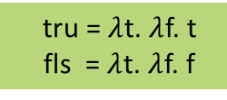





Programming in the $λ$-Calculus (Ctd.)
Another language feature that can easily be encoded in the lambda-calculus is Boolean values and conditionals. Define the terms tru and fls as follows:
The terms tru and fls can be viewed as representing the Boolean values “true” and “false,” in the sense that we can use these terms to perform the operation of testing the truth of a Boolean value. In particular, we can use application to define a combinator test with the property that “test b v w” reduces to v when b is tru and reduces to w when b is fls.
In fact,
Moreover, we can define Boolean operators like conjunction, disjunction, and negation:
tru = $λ$t. $λ$f. t
fls = $λ$t. $λ$f. f
introduction (introductory forms)
test = $λ$l. $λ$m. $λ$n. l m n
elimination (eliminatory forms)
test b v w
$$=$$
($λ$l. $λ$m. $λ$n. l m n) b v w
$$⟶$$
($λ$m. $λ$n. b m n) v w
$$⟶$$
($λ$n. b v n) w
$$⟶$$
b v w
test tru v w
$$⟶^{∗}$$
tru v w
$$⟶$$
v
test fls v w
$$⟶^{∗}$$
fls v w
$$⟶$$
w
and = $λ$b. $λ$c. b c fls
or = $λ$b. $λ$c. b tru c
neg = $λ$b. b fls tru

Slide 12







Programming in the $λ$-Calculus (Ctd.)
Using Booleans, we can encode pairs of values as:
That is, “pair v w” is a function that, when applied to a Boolean value b, applies b to v and w. By the definition of Booleans, this application yields v if b is tru and w if b is fls, so the first and second projection functions fst and snd can be implemented simply by supplying the appropriate Boolean.
Representing numbers by lambda-terms is only slightly more intricate than what we have just seen. Define the Church numerals c₀, c₁, c₂, etc., as follows:
That is, each number n is represented by a combinator c_{n} that takes two arguments, s and z (for successor and zero), and applies s, n times, to z.
As with Booleans and pairs, this encoding makes numbers into active entities: the number n is represented by a function that does something n times.
pair = $λ$f. $λ$s. $λ$b. b f s
fst = $λ$p. p tru
snd = $λ$p. p fls
c₀ = $λ$s. $λ$z. z,
c₁ = $λ$s. $λ$z. s z,
c₂ = $λ$s. $λ$z. s (s z),
c₃ = $λ$s. $λ$z. s (s (s z)), …

Slide 13







Programming in the $λ$-Calculus (Ctd.)
We can define the successor function on Church numerals as follows:
The term scc is a combinator that takes a Church numeral n and returns another Church numeral. We get the right number of applications of s to z by first passing s and z as arguments to n, and then explicitly applying s one more time to the result.
Similarly, addition of Church numerals can be performed by a term plus that takes two Church numerals, m and n, as arguments, and yields another Church.
For example,
Applying “plus” to just one argument n yields the function that adds n to whatever argument it is given. Passing this function as the first argument to m and c₀ as the second argument means “apply the function that adds n to its argument, iterated m times, to zero,” i.e., “add together m copies of n.”
scc = $λ$n. $λ$s. $λ$z. s (n s z)
plus = $λ$m. $λ$n. $λ$s. $λ$z. m s (n s z)
plus c₂ c₃
$⟶^{∗}$ $λ$s. $λ$z. c₂ s (c₃ s z)
$⟶^{∗}$ $λ$s. $λ$z. c₂ s (s (s (s z)))
$⟶^{∗}$ $λ$s. $λ$z. s ( s (s (s (s z))))
$=$ c₅
times = $λ$m. $λ$n. m (plus n) c₀

Slide 14





Programming in the $λ$-Calculus (Ctd.)
To test whether a Church numeral is zero, we may apply the following combinator to the numeral.
Surprisingly, subtraction using Church numerals is quite a bit more difficult than addition. It can be done using the following rather tricky “predecessor function,” which, given c₀ as argument, returns c₀ and, given c_{i+1}, returns c_{i} :
To implement subtraction, one may now propose the following combinator.
iszro = $λ$m. m ($λ$x. fls) tru
zz = pair c₀ c₀
ss = $λ$p. pair (snd p) (plus c₁ (snd p))
prd = $λ$m. fst (m ss zz)
ss
ss
ss
ss
(c₀, c₀)
(c₀, c₁)
(c₁, c₂)
$$⋅ ⋅ ⋅$$
(c_{m-1}, c_{m})
subtract = $λ$m. $λ$n. n prd m

Slide 15
Types and Programming Languages by Benjamin Pierce (Chapter 5)

